Slide 1

Step-by-Step Instructions for Group Assignment
International Cryptographic Institute: Advancing Cryptography Education and Research
Lecturer/Tutor: Dr. Farshid Keivanian

Slide 2
Instructions:
Join a Group:
Form a group of 4 students within the first two weeks of class. Each group will work together for the semester.
Download Assignment Documents:
Access and download the detailed group assignment specifications from the provided documents:
Group Assignment Cover Sheet 2024.docx
HS1021 Group Assignment T1 2024.pdf
OPTION 1.pdf
OPTION 2.pdf
OPTION 3.pdf
OPTION 4.pdf

Slide 3
3. Review Requirements:
Ensure submission includes a completed cover sheet with all contributing group members listed.
Use Microsoft Word format for the report.
Correctly reference all sources using Holmes Institute Adapted Harvard Referencing.
Submit documents from a desktop or laptop, not from a smartphone/tablet or via the Blackboard App.

Slide 4
4. Complete the Group Assignment:
Follow the assignment guidelines and address both challenges within your selected option. Each group must select one of the four provided options.
5. Submit the Group Assignment:
Submit the completed group assignment and cover sheet to the submission link on Blackboard by the due date and time.

Slide 5
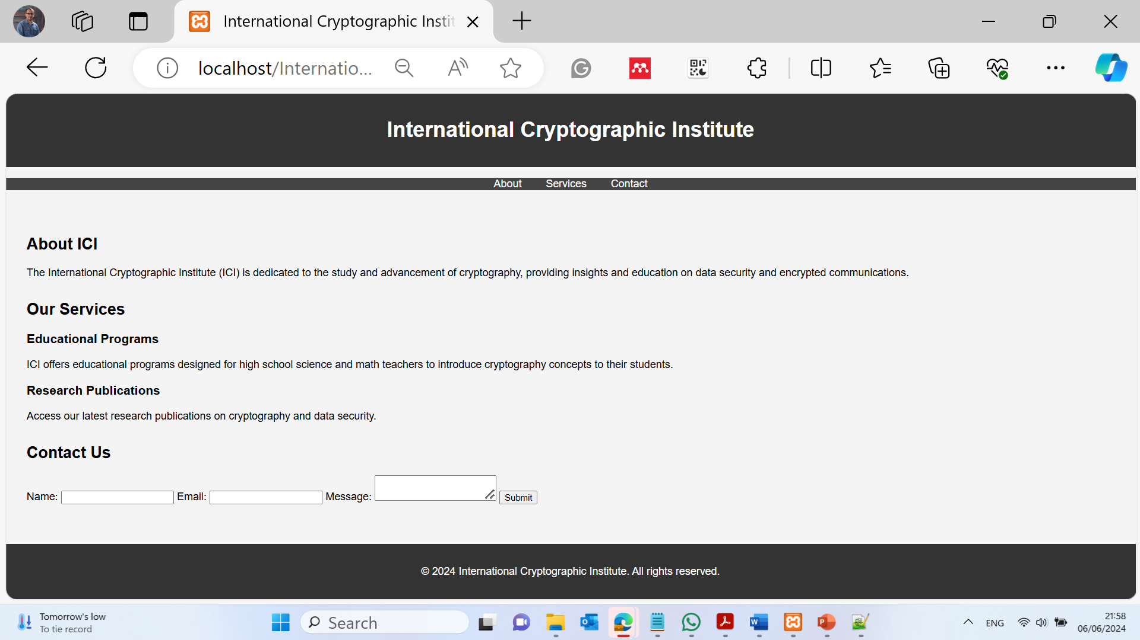
Option 3: Challenge 1 - International Cryptographic Institute (ICI)
HTML and CSS Code Example:
HTML (index.html): International Cryptographic Institute: Advancing Cryptography Education and Research.html

Slide 6
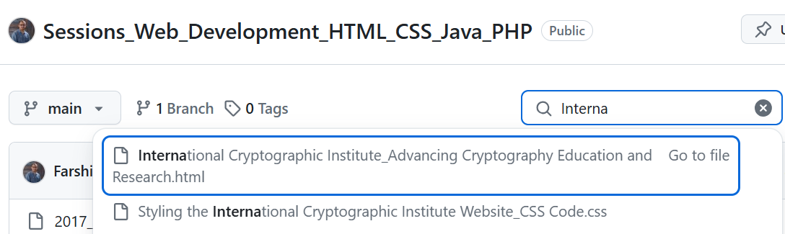
Option 3: Challenge 1 - International Cryptographic Institute (ICI)
HTML and CSS Code Example:
HTML (index.html): International Cryptographic Institute: Advancing Cryptography Education and Research.html

Slide 7
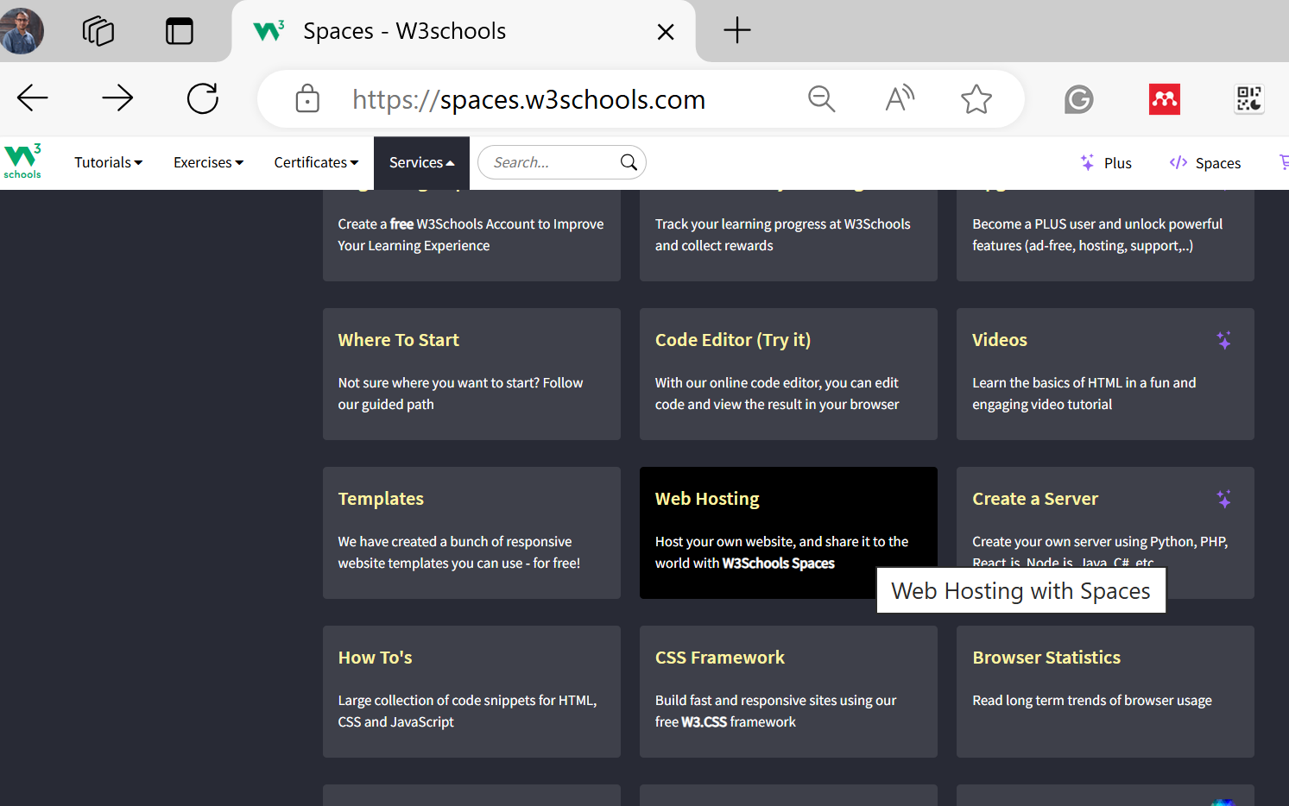
Option 3: Challenge 1 - International Cryptographic Institute (ICI)
HTML and CSS Code Example:
HTML (index.html): International Cryptographic Institute: Advancing Cryptography Education and Research.html

Slide 8
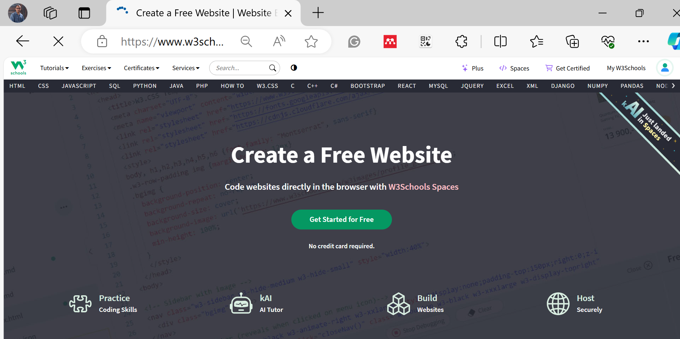
Option 3: Challenge 1 - International Cryptographic Institute (ICI)
HTML and CSS Code Example:
HTML (index.html): International Cryptographic Institute: Advancing Cryptography Education and Research.html

Slide 9
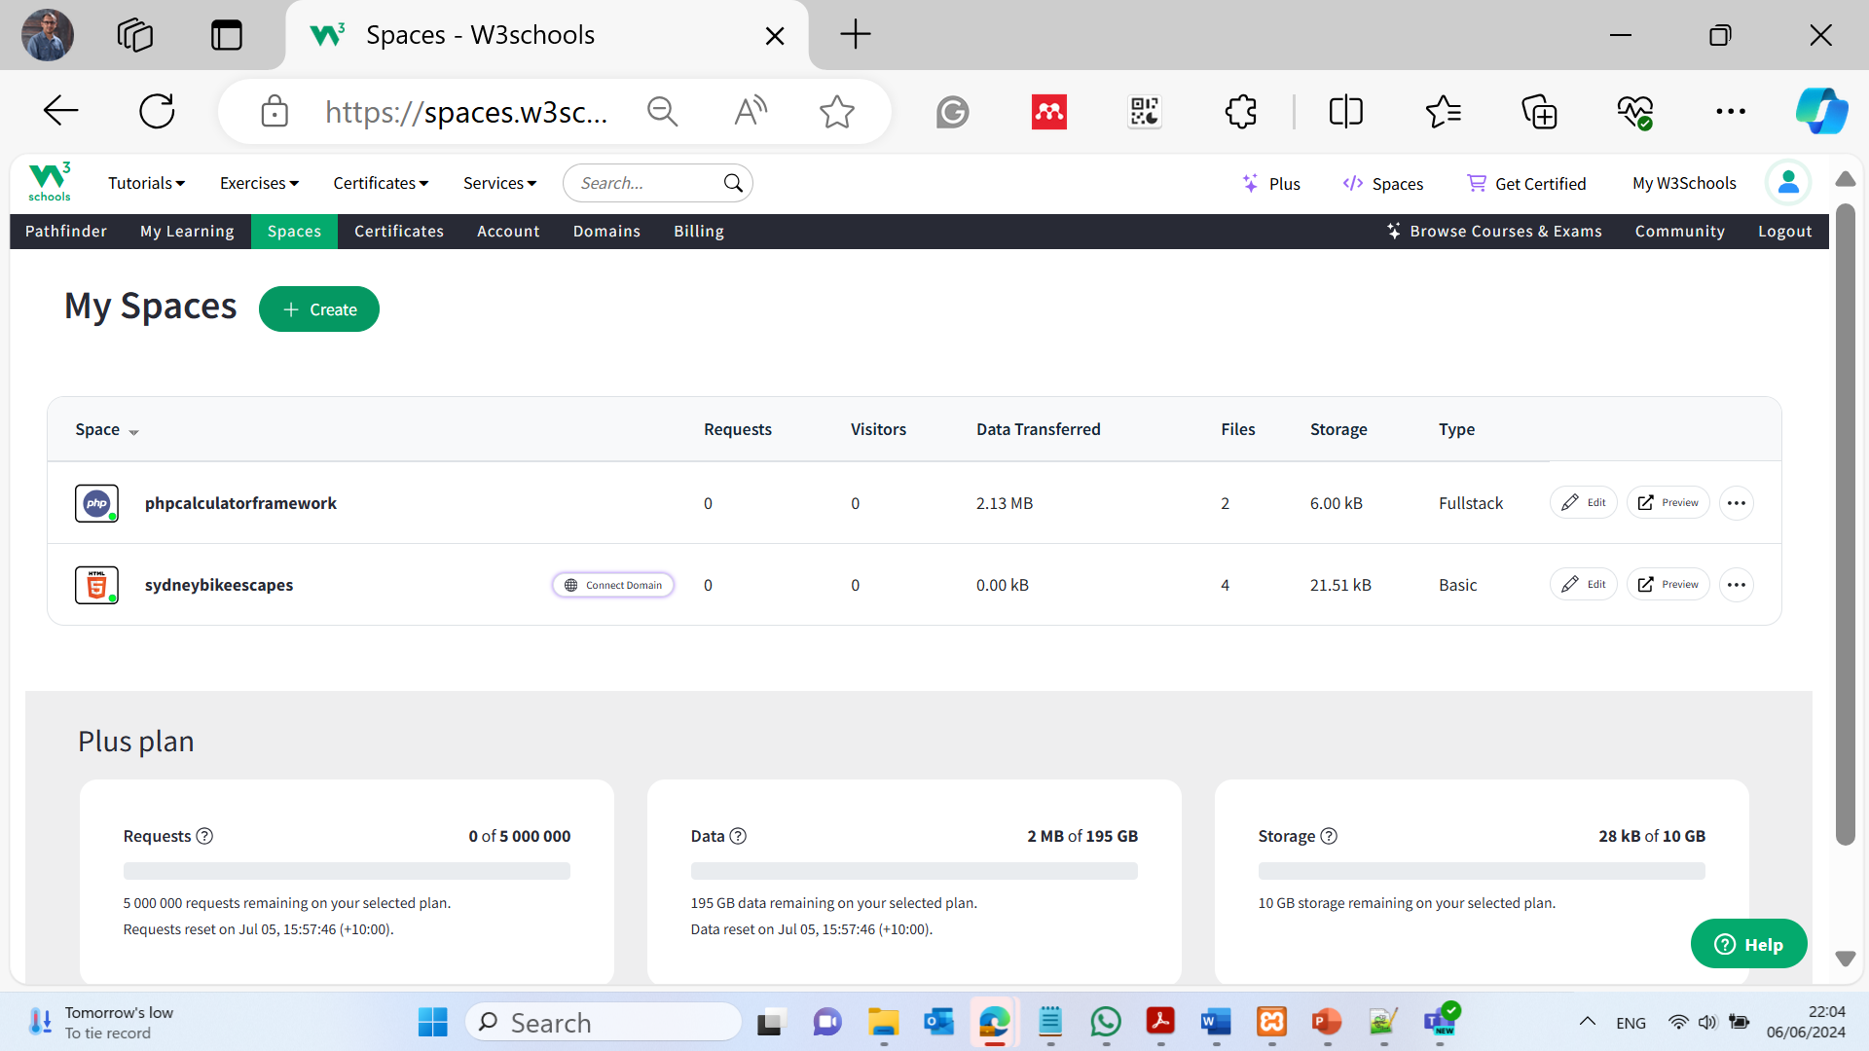

Slide 10
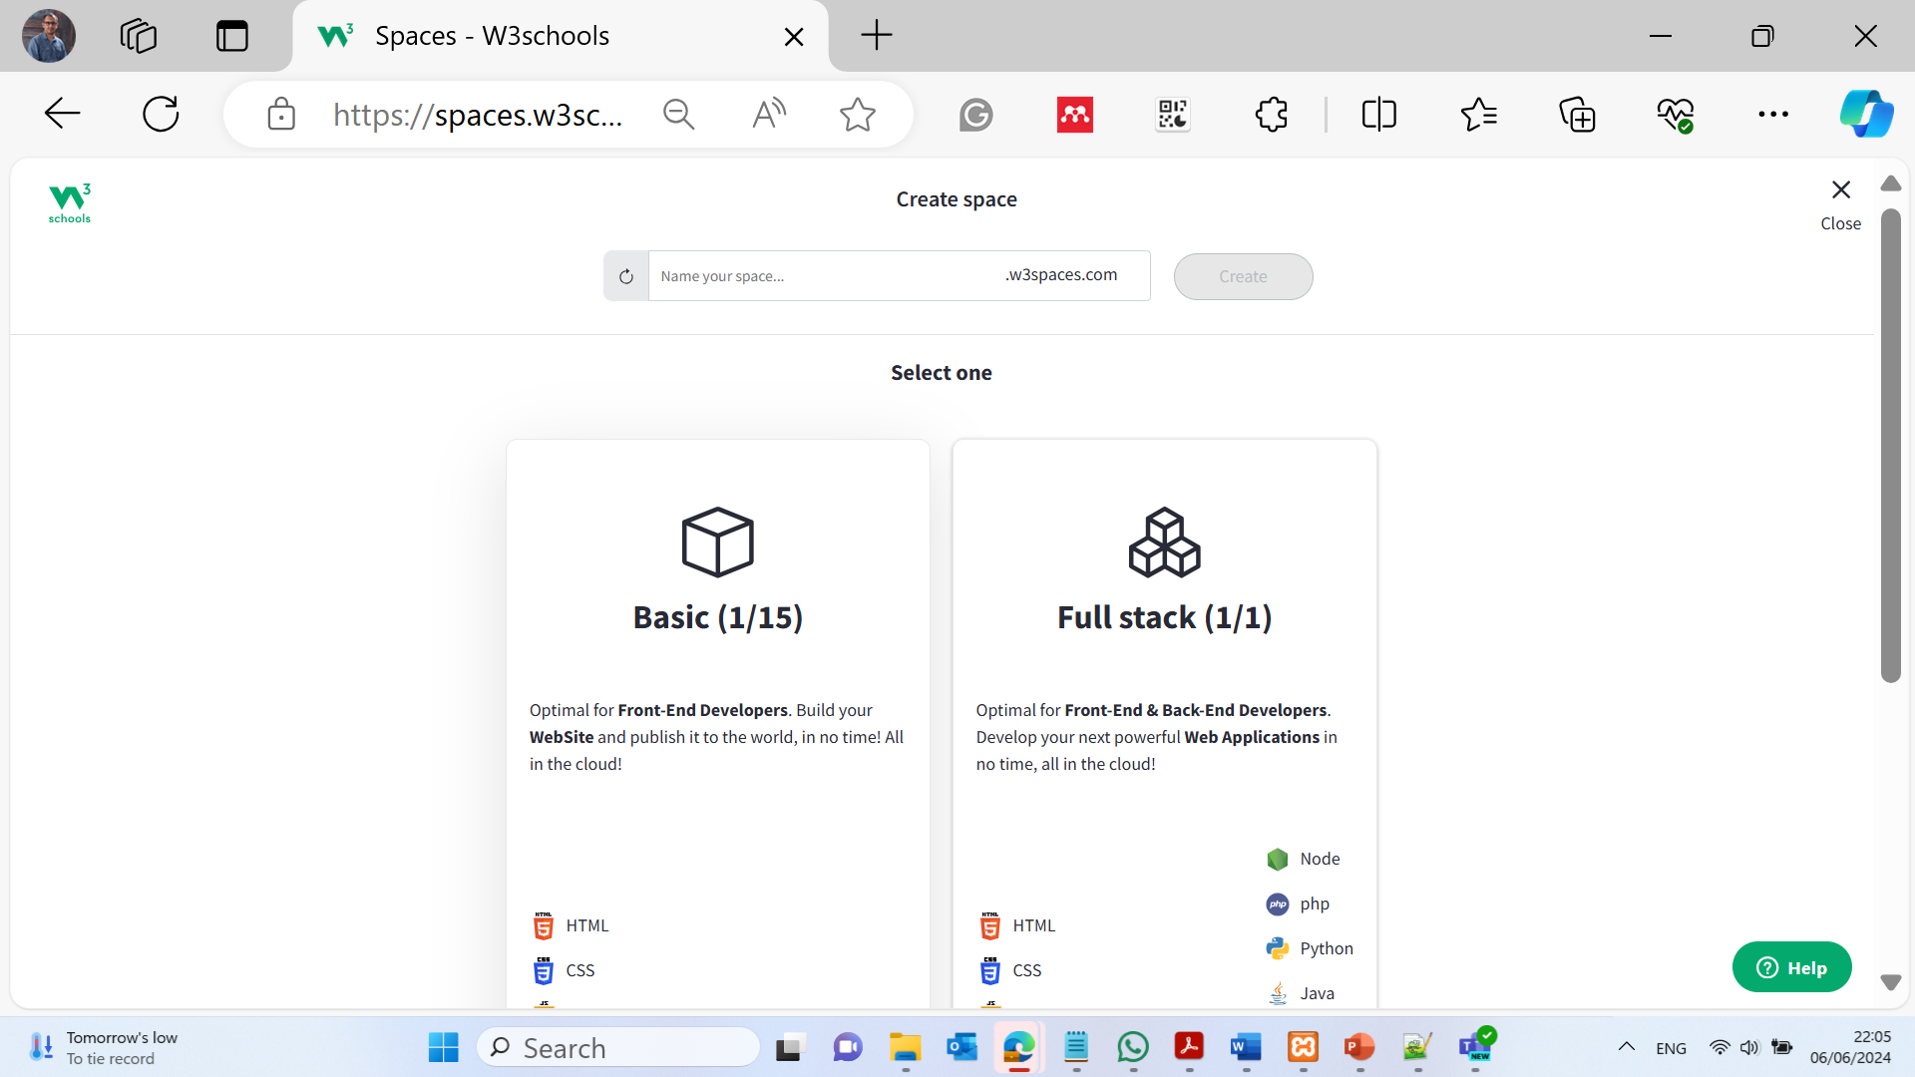

Slide 11
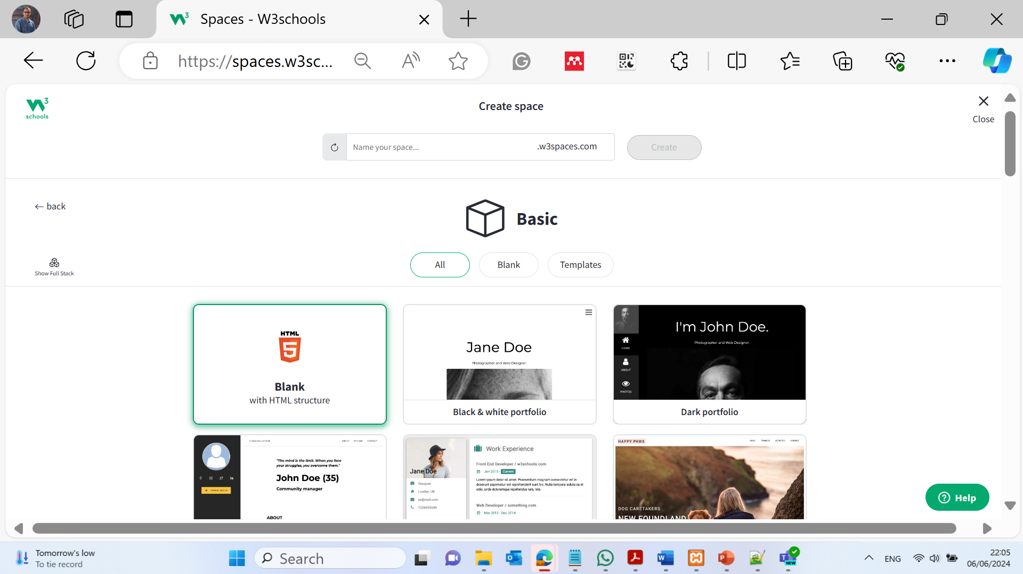

Slide 12
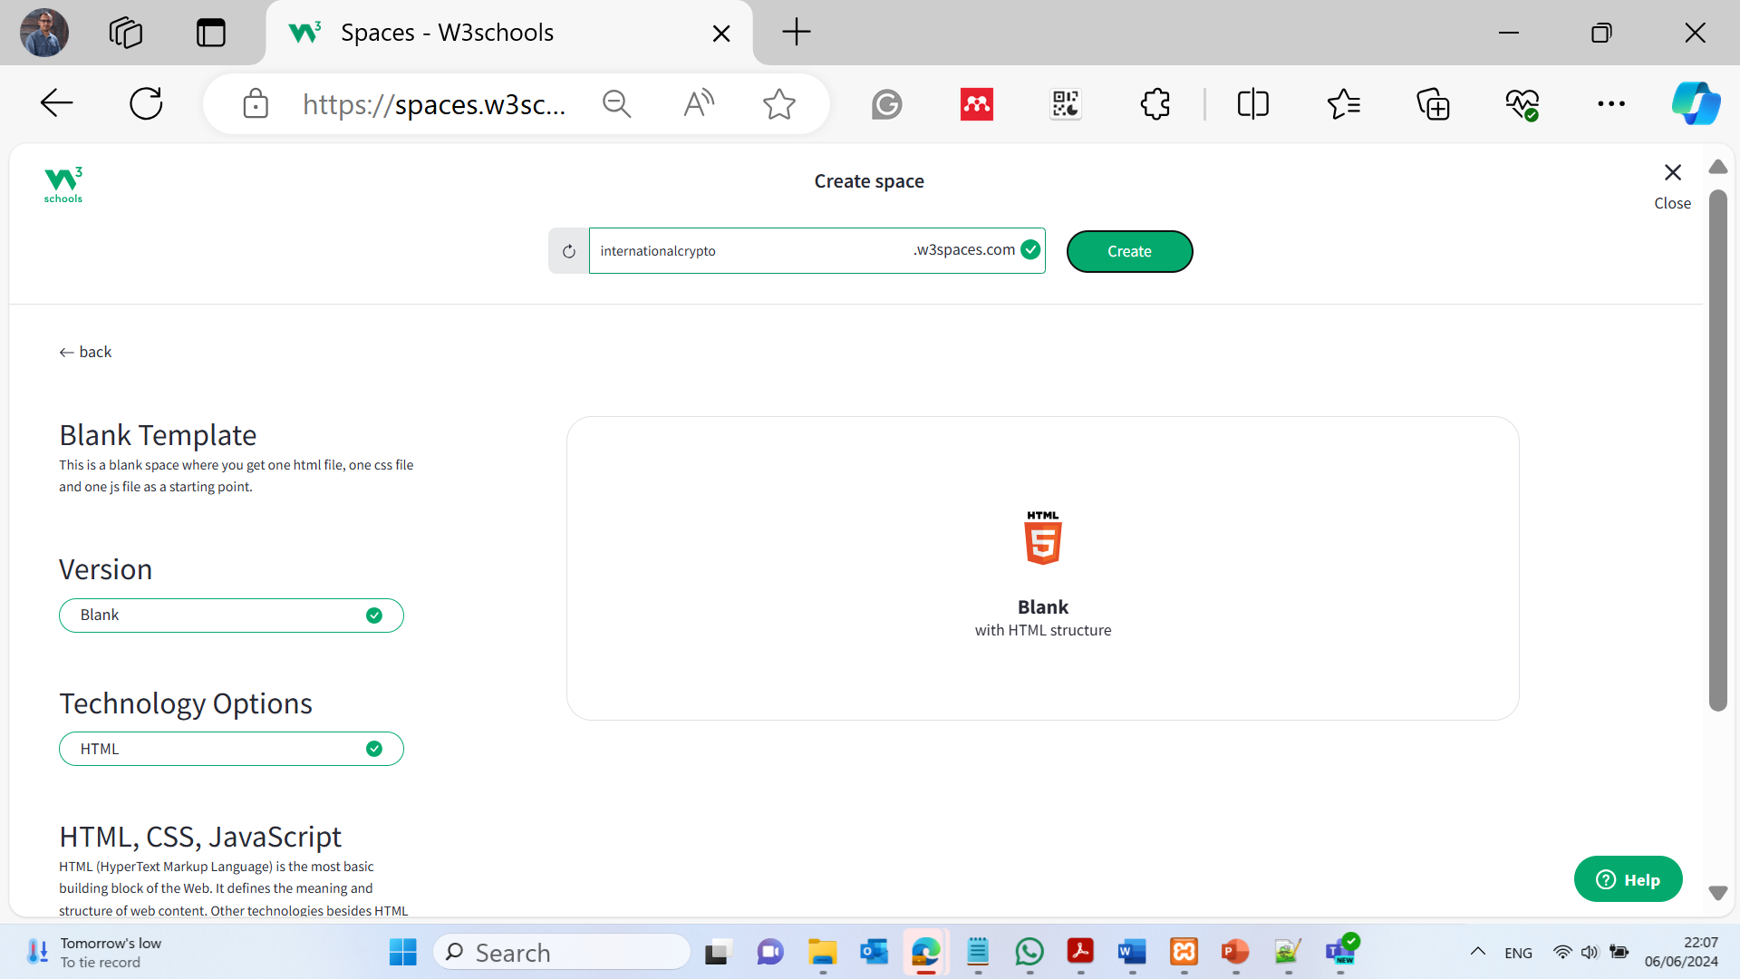

Slide 13
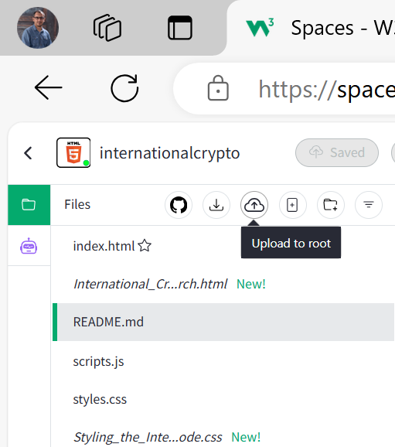
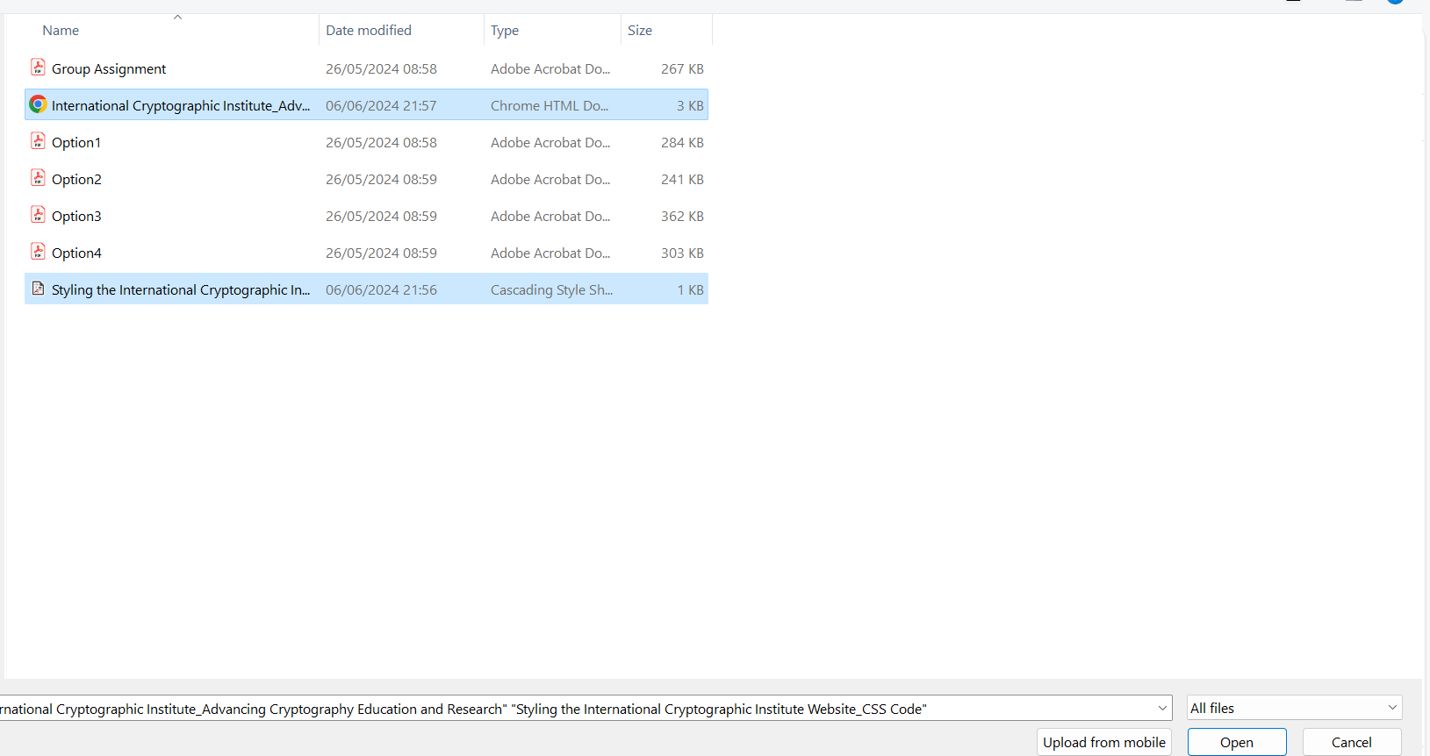

Slide 14
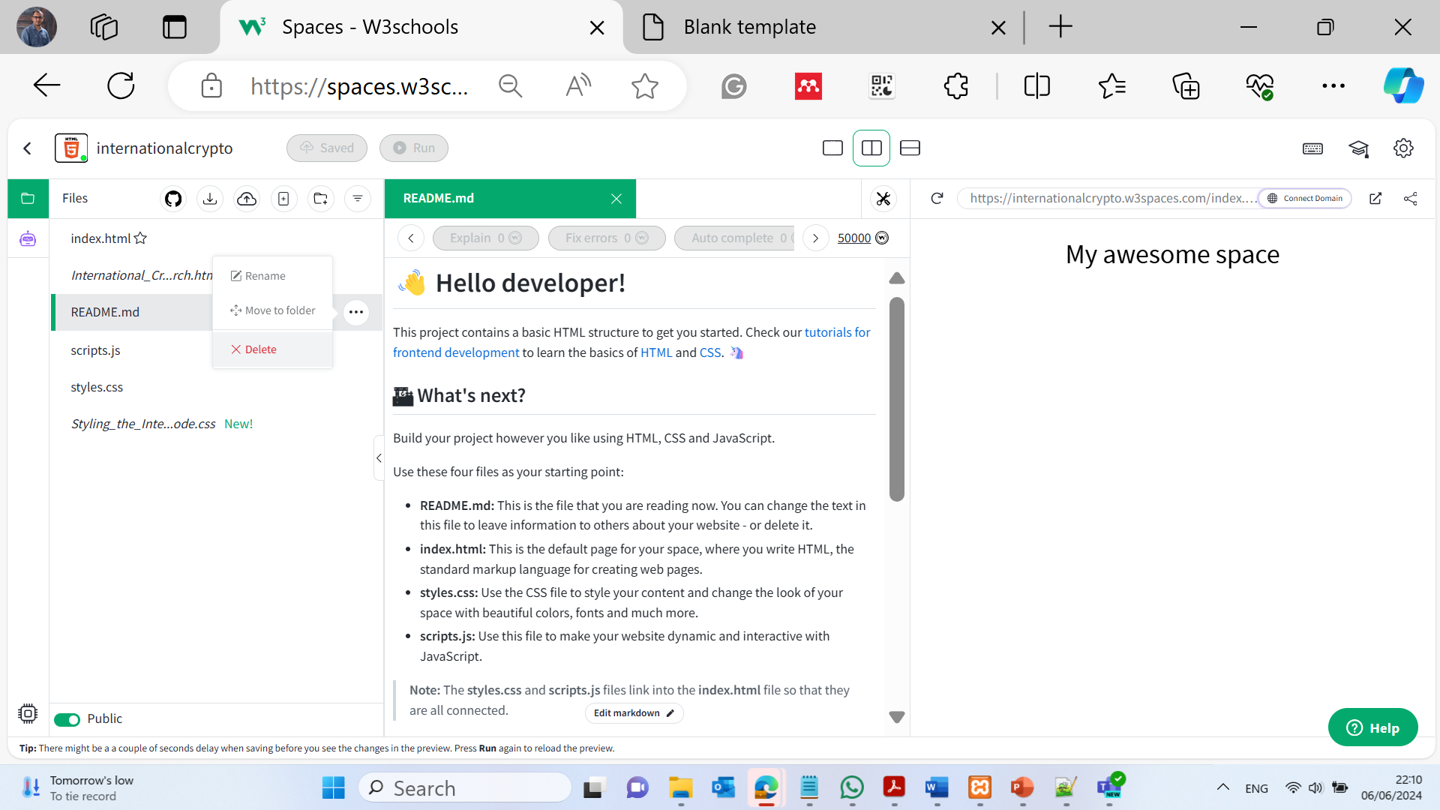

Slide 15
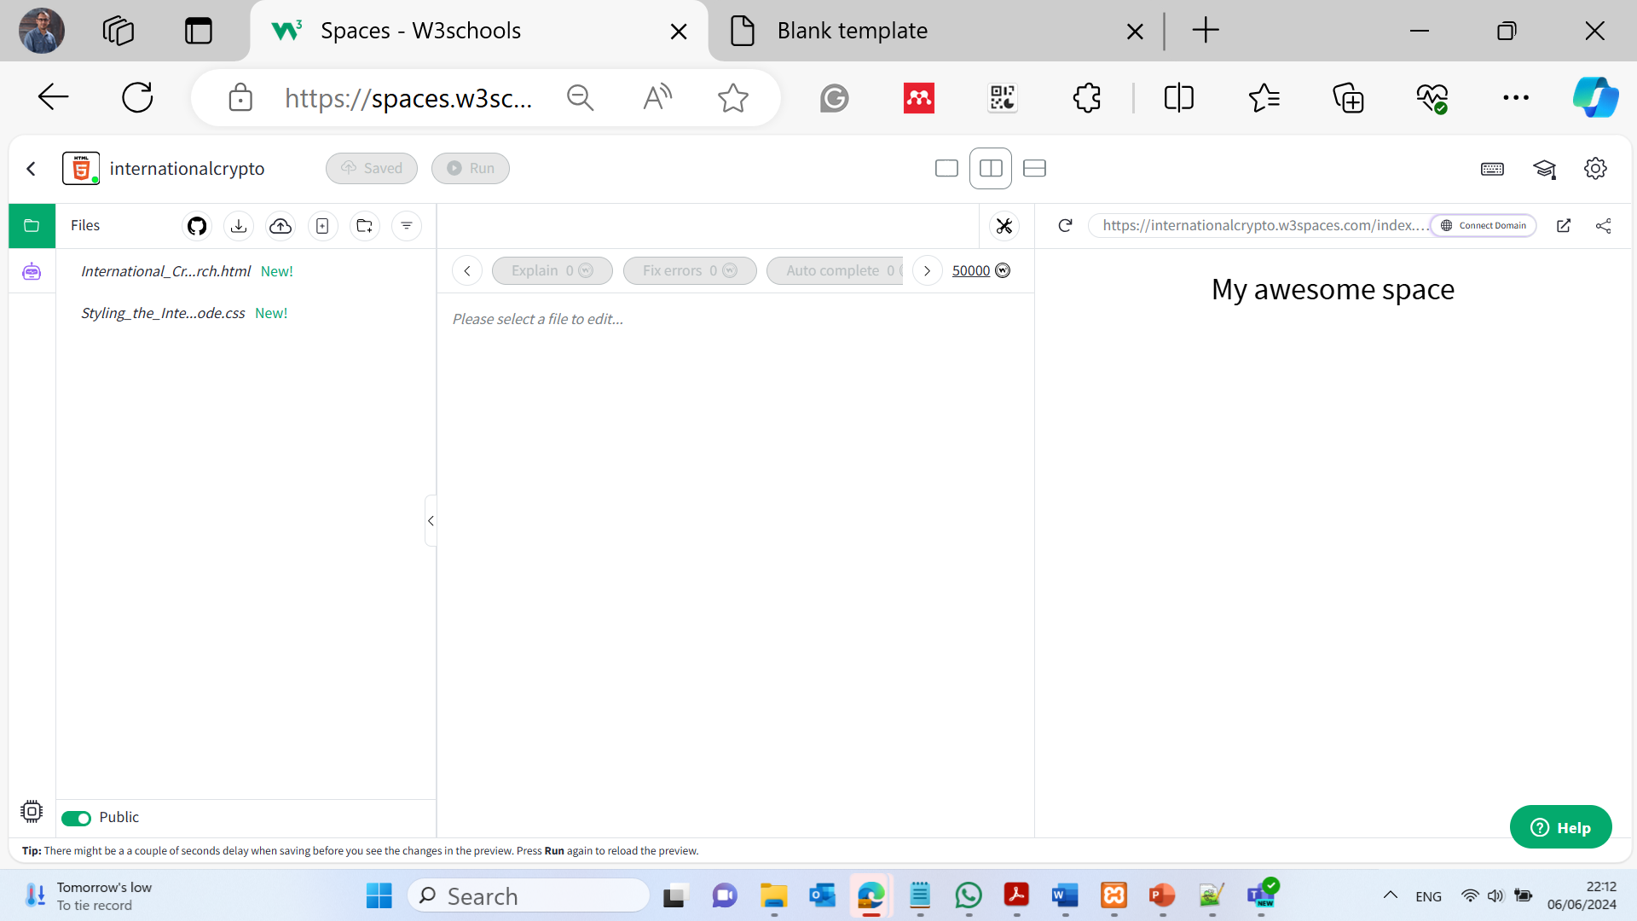

Slide 16
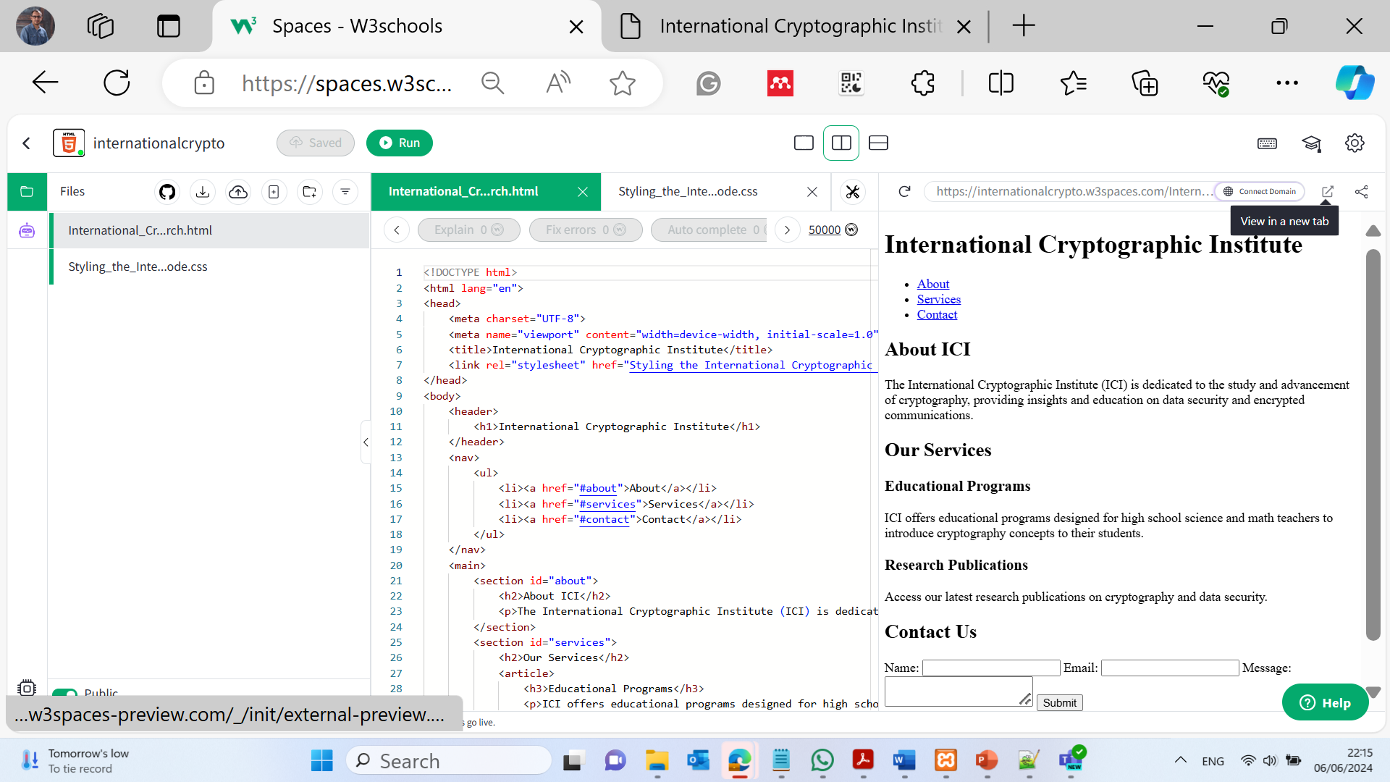

Slide 17
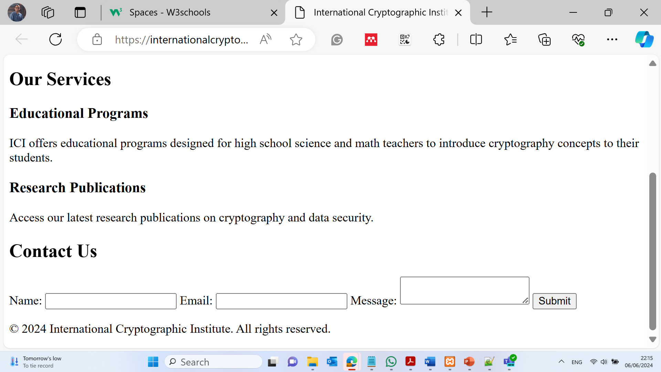
https://internationalcrypto.w3spaces-preview.com/International_Cryptographic_Institute_Advancing_Cryptography_Education_and_Research.html

Slide 18

Happy a Learning Day! Dr. Farshid Keivanian

